Slide 1
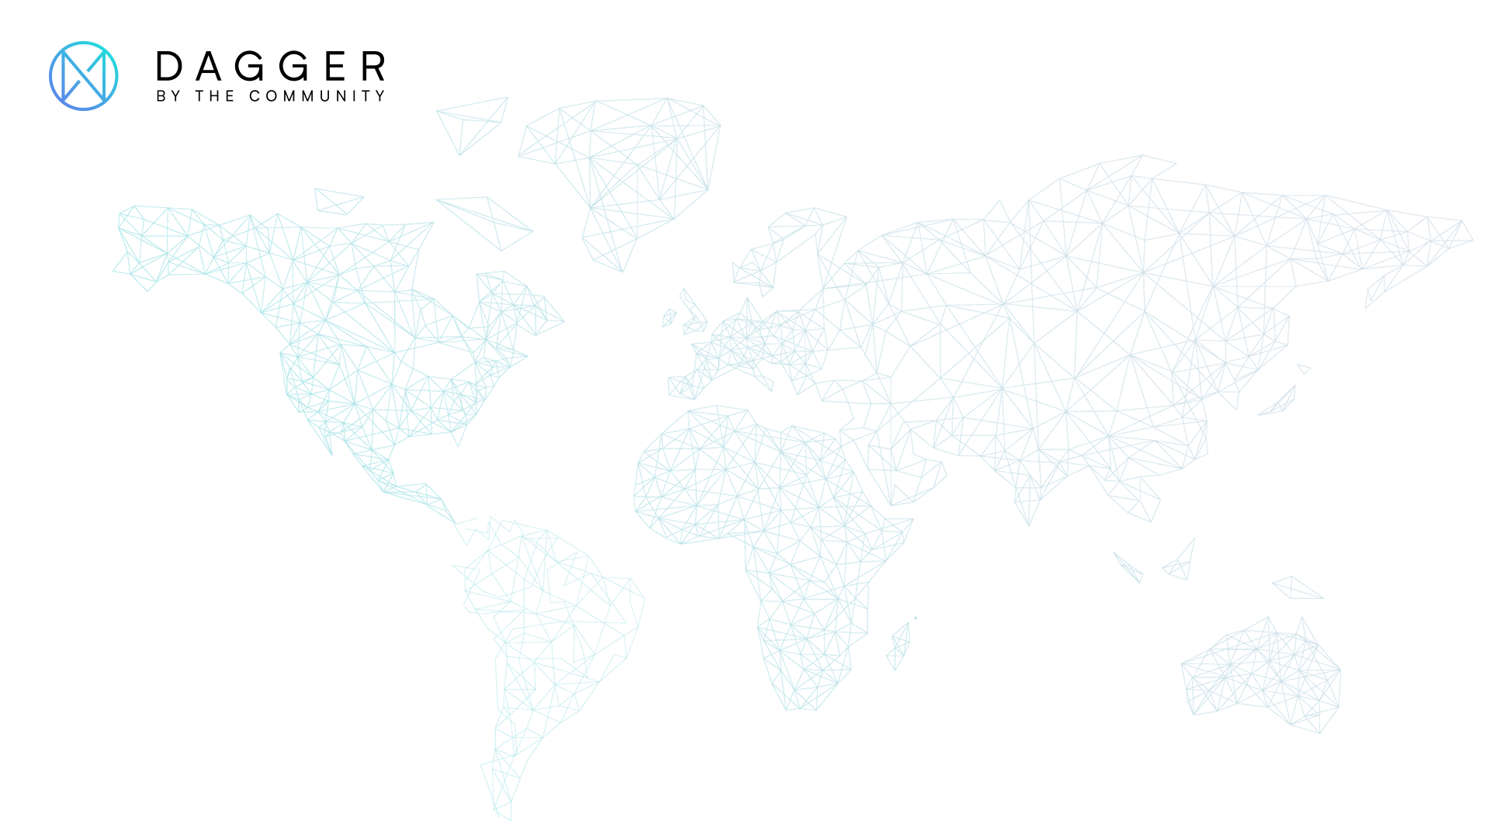
XDAG: PoW + DAG
frozen@xdag.io
https://github.com/xrdavies

Slide 2
State-of-The-Art
Bitcoin
Ethereum
EOS
Blockchain tech is facing problems
???

Slide 3
State-of-The-Art
Layer1
Layer2
DAG
Consensus PoS/DPoS
Side Chain
Nano
IOTA
State Channels
Shading
Byteball
Multi Chains
XDAG

Slide 4
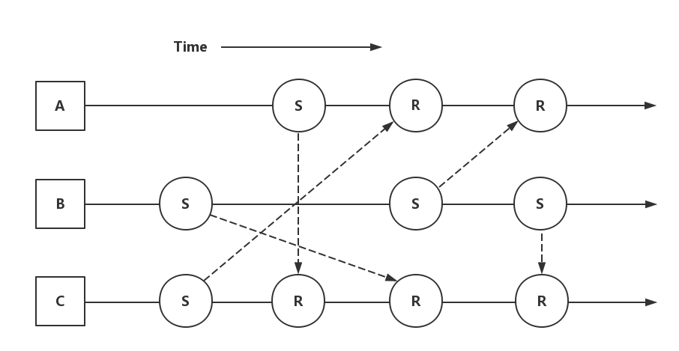
NANO

Slide 5
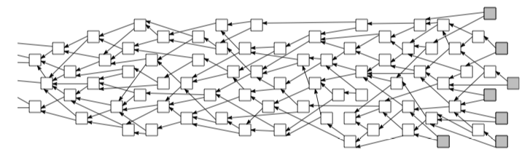
IoTA

Slide 6
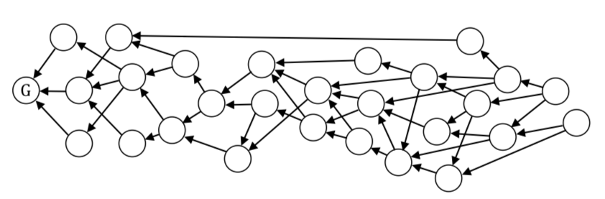
Byteball

Slide 7
DAG – Directed Acyclic Graph
XDAG is another innovation technology to solve problems

Slide 8
XDAG: A new DAG-based cryptocurrency
The first mineable DAG
No Pre-mine
No ICO
Community driven

Slide 9
DAG - Directed Acyclic Graph
PoW
Decentralized
High TPS
Block = Transaction = Address
Blockchain tech friendly

Slide 10
Tx
Tx
Tx
Tx
Tx
Tx
Tx
Tx
A
Tx
Tx
W
Tx
A
W
W
W
M
M
A
M
M
M
A
W
Tx
W
Tx
Tx
Tx
Tx
Tx
G
Tx
W
Tx
Tx
Tx
Tx
Tx
Tx
Tx
Tx
Tx
W
Tx
Tx
Tx
W
A
W
M
W
M
M
W
M
M
W
W
A
Tx
A
Tx
A
Tx
Tx
Tx
Tx
Tx
A
Tx
Tx
Tx
Tx
Tx
Tx

Slide 11
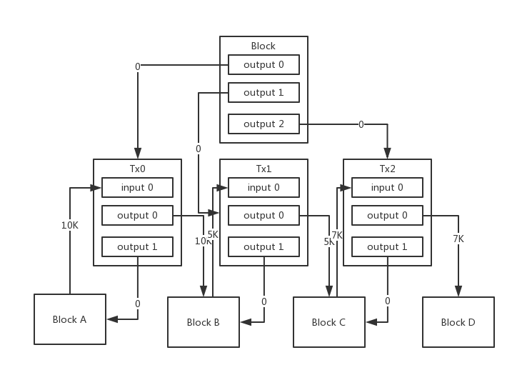
UTXO
XDAG UTXO

Slide 12
Blockchain

Slide 13
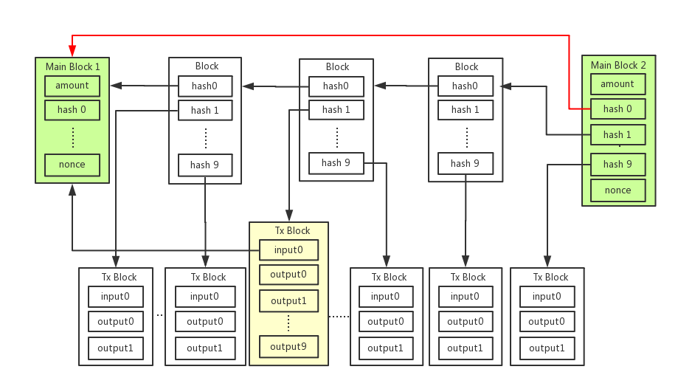
XDAG

Slide 14
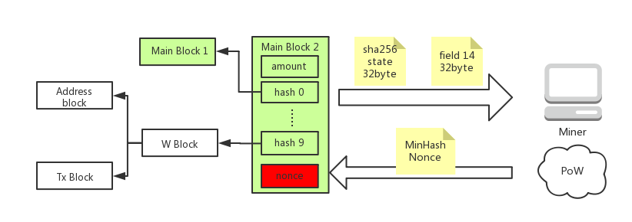
PoW: The Spirit of Blockchain

Slide 15
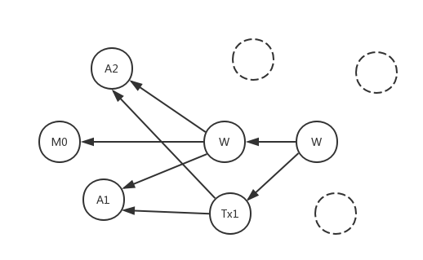
Simple Transaction case
A1 A2 address
M0 main block
Tx1 transaction
W witness block

Slide 16
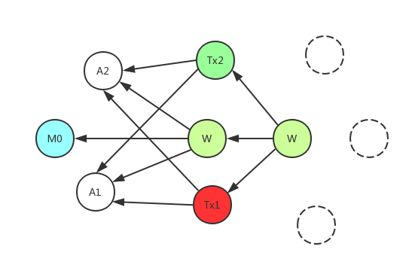
Double spend 1
double spend case on same node
A1, A2 are wallet block
Tx1, Tx2 are Txs from A1 to A2.
Detected by ref orders directly.

Slide 17
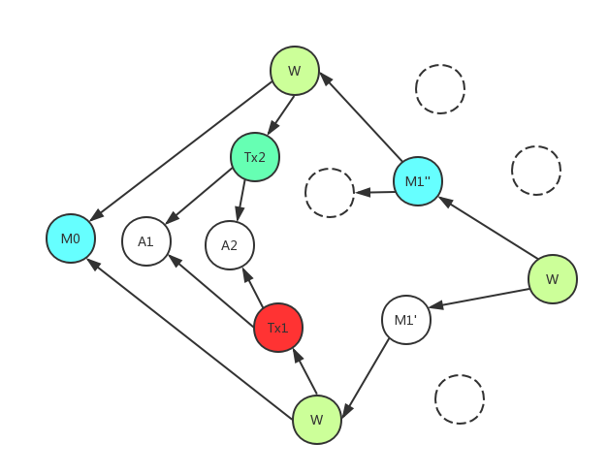
Double spend 1
double spend case on different nodes
A1, A2 are wallet block
Tx1, Tx2 are Txs from A1 to A2.
Detected by ref orders and block difficulties.

Slide 18
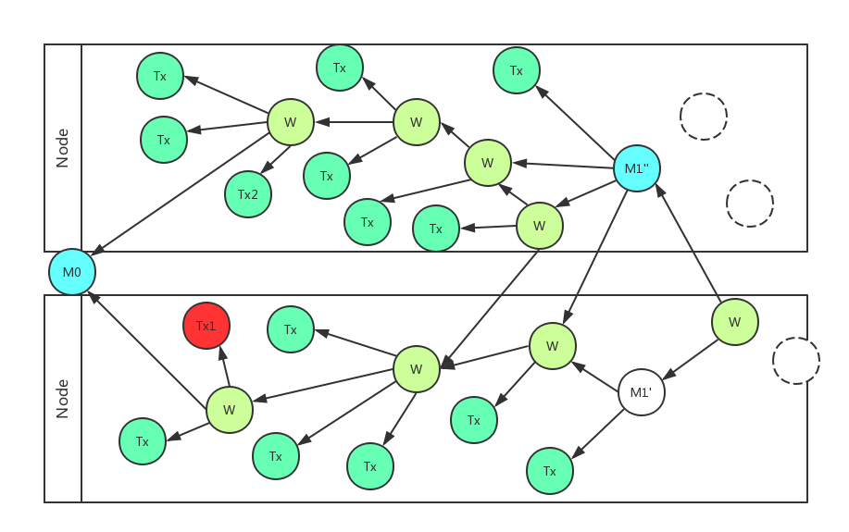
High TPS
each node process its transactions and construct self sub-DAG. Then merge them together through mined main blocks.

Slide 19
Community Driven
No ICO, No Pre-mining, No investment, No capitals
Community members are from different social channels
Current developers are from different countries who never met each other

Slide 20
Current State
Main net started since Jan 5th 2018
Current release 0.3.0
GUI wallet for Windows, Mac and Linux is Ready
Android Wallet is Ready
iOS Wallet is Ready
RPC in Ready
10 exchanges listed XDAG

Slide 21
Next step
Smart Contract
Anonymous Trading
Hash algorithm adjustment

Slide 22
How to Join & Help Community
Everyone related to XDAG is part of community
Spread XDAG
Discuss proposal
Report issues
Translation
Contribute code

Slide 23
Thank you!
Thanks to all developers!
Evgeniy, Frozen, sgaragagghu, AnythingTechPro
Bill, Solar, ssyijiu, trueserve, Toneyisnow, czslience, kbs1
rubencm, Jimmy, mathsw, Wendy
Thanks to all Miners, Pool Owners, Community Members
and
other Contributors

Slide 24
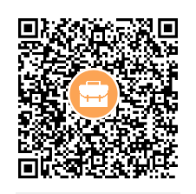
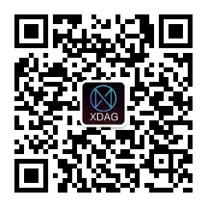
Dev QQ Group
WeChat Official Account

